Slide 1
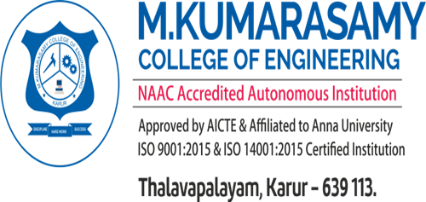


DEPARTMENT OF ELECTRONICS AND COMMUNICATION ENGINEERING
MINOR PROJECT-IV
ZEROTH REVIEW
AUTOMATIC RAILWAY GATE CONTROL
PRESENTED BY: GUIDE:
K.NAVEENA [927621BEC136] Mrs.P.SANMUGAVALLI
G.PAVIPRAVEENA [927621BEC142]
S.SARANYA [927621BEC186]

Slide 2
Introduction
Accidents at the level crossings and on rail tracks are increasing day by day.
The main reason behind it is the careless operation of human workers , lack of resources and lack of technology.
The main purpose of designing the model of this system is to provide automatic control railway gates at level crossings replacing human interference.
This project deals with one of the efficient method to avoid train accidents.

Slide 3
Aim
The main aim of this project is to automize the unmanned railway gate.
The gate is closed automatically whenever the train comes and is opened after the train leaves the railway-road crossing.
It is highly economical microcontroller based arrangement, designed for use in almost all the unmanned level crossings in the country.
It is also help by improving safety at railway crossings by reducing the risk of accidents caused by human unconsciousness.

